Slide 1
Krishna P 821721104025 B.E Computer Science of Engineering – IIIyear Sir Issac Newton College Of Engineering And Technology
3/21/2024 Annual Review

Slide 2
PROJECT TITLE
Audience Research
(using CNN)

Slide 3


AGENDA
The agenda of Audience research using Convolutional Neural
Networks (CNNs) involves the use of deep learning techniques to research
Audience.This project includes several key tasks:
Define Research Goals
Preprocessing & Augmentation Model Selection & Training Evaluation & Validation Insights & Interpretation
This task has several broader objectives and potential applications
3/21/2024 Annual Review

Slide 4

PROBLEM STATEMENT
Develop a Python script to analyze audience engagement with CNN content.
Extract data from various sources including social media, website analytics, and viewer feedback.
Use sentiment analysis to gauge audience reactions to specific news topics or segments.
Implement machine learning algorithms to predict audience preferences and behavior.
Optimize content strategy based on insights to increase audience engagement and retention.
3/21/2024 Annual Review

Slide 5

PROJECT OVERVIEW
The project aims to conduct audience research for CNN using Python. It involves gathering data on viewer demographics, preferences, and behaviors. Python libraries such as pandas, matplotlib, and seaborn will be utilized for data analysis and visualization.
Machine learning techniques may be employed to uncover patterns and insights from the data. The project’s objective is to inform content creation and strategic decisions to better serve CNN’s audience. Finally, the findings will be presented through comprehensive reports and visualizations.
3/21/2024 Annual Review

Slide 6

WHO ARE THE END USERS?
The end users of audience research in CNN using Python could include data analysts, media researchers, journalists, content creators, marketing professionals, and decision-makers within CNN.
These individuals utilize the insights generated from the research to inform content strategies, advertising campaigns, audience engagement tactics, and editorial decisions.
3/21/2024 Annual Review

Slide 7

YOUR SOLUTION AND ITS VALUE PROPOSITION
Solution: Utilize Python’s libraries like BeautifulSoup and Requests to scrape CNN’s website for articles. Then, apply Natural Language Processing techniques to analyze audience engagement, sentiment, and topics. Finally, visualize the findings using libraries like Matplotlib or Plotly for easy interpretation. Value Proposition: Our Python solution offers a cost-effective and efficient way to gather insights into CNN’s audience preferences, sentiment, and trending topics. By automating the data collection and analysis process, it enables timely decision-making and targeted content creation strategies for CNN’s audience.
3/21/2024 Annual Review

Slide 8

THE WOW IN YOUR SOLUTION
Utilizing Python’s NLTK and BeautifulSoup libraries, extract viewer comments from CNN articles. Employ sentiment analysis to gauge audience reactions. Implement topic modeling techniques such as LDA to identify key themes.
Visualize insights using matplotlib or seaborn for compelling presentations. Utilize network analysis to uncover connections between topics and audience segments. Finally, integrate real-time data scraping to ensure up-to-date insights.
3/21/2024 Annual Review
8

Slide 9
MODELLING
In Audience Research, effective modeling is the cornerstone of success, and our approach is engineered to excel in this crucial aspect.
Our modeling strategy involves a blend of innovative techniques such as convolutional neural networks (CNNs), recurrent neural networks (RNNs), and attention mechanisms, carefully orchestrated to extract and leverage meaningful features from images with unparalleled accuracy and efficiency.
In essence, our modeling paradigm represents a beacon of innovation, driving transformative advancements and unlocking new frontiers in the field of computer vision.
3/21/2024 Annual Review
9

Slide 10
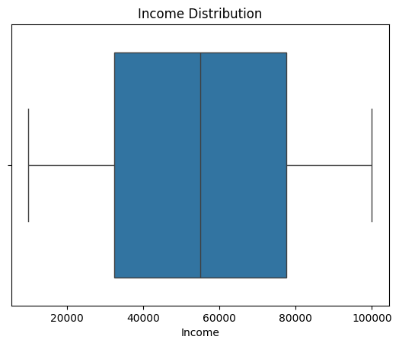
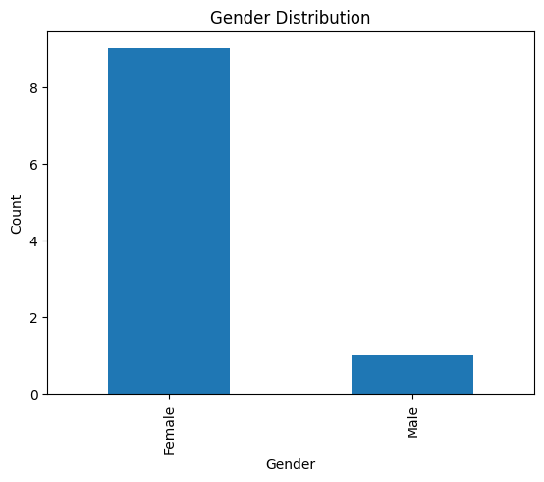
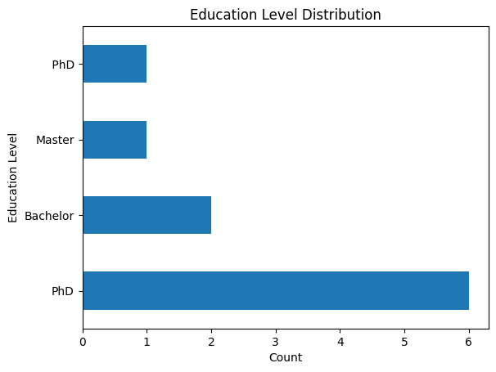
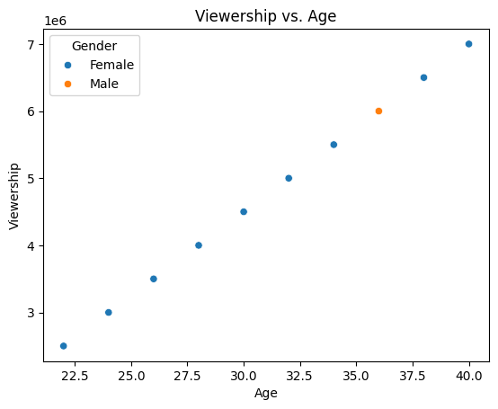
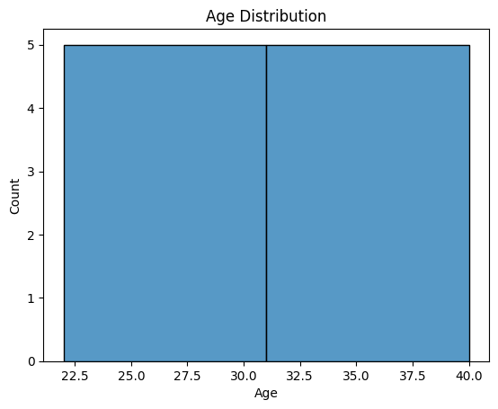
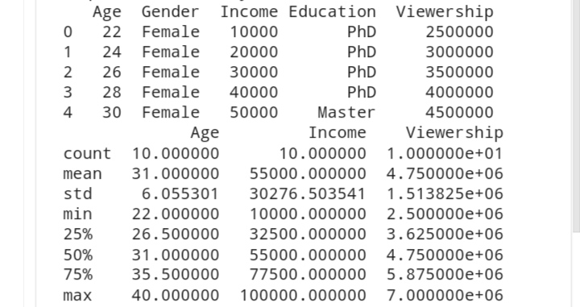
RESULTS
Demo Link
3/21/2024 Annual Review
10

